Slide 1




DIGITAL LITERACY
SKILLS
INTERMEDIATE USERS

Slide 2

Module 5
Safety and security

Slide 3

3
Unit 3: Protecting health and well-being

Slide 4
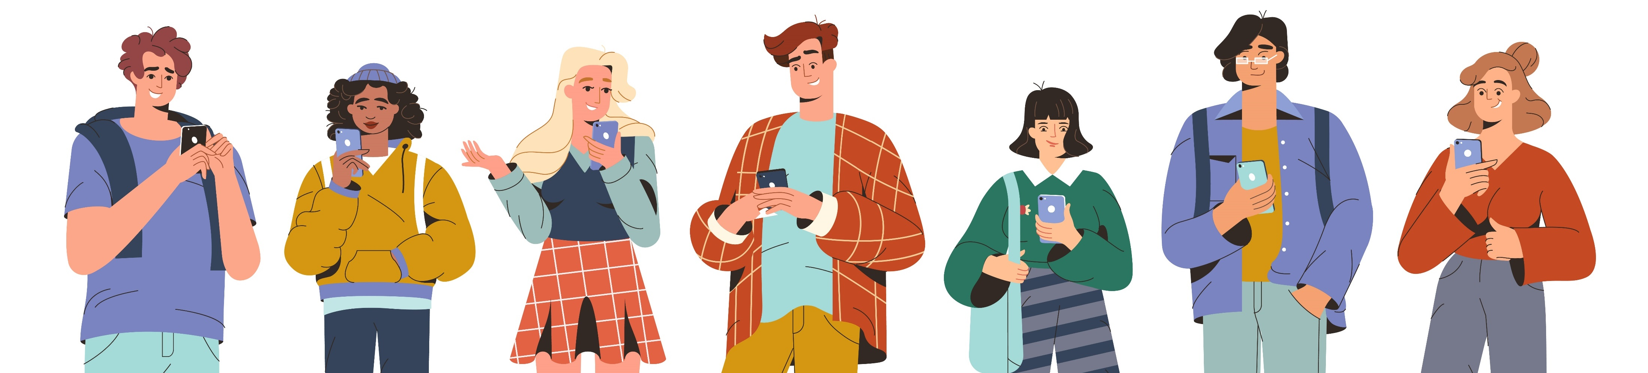
Negative effects of technology: what to know
Some forms of technology may have made positive changes in the world, there is also evidence for the negative effects of technology and its overuse.
Social media and mobile devices may lead to psychological and physical issues.

Slide 5

Physical health effects
Eyestrain
Using technologies for long periods may lead to eyestrain.
Symptoms of digital eyestrain can include blurred vision and dry eyes.
Eyestrain may also lead to pains in other areas of the body, such as the head, neck, or shoulders.

Slide 6
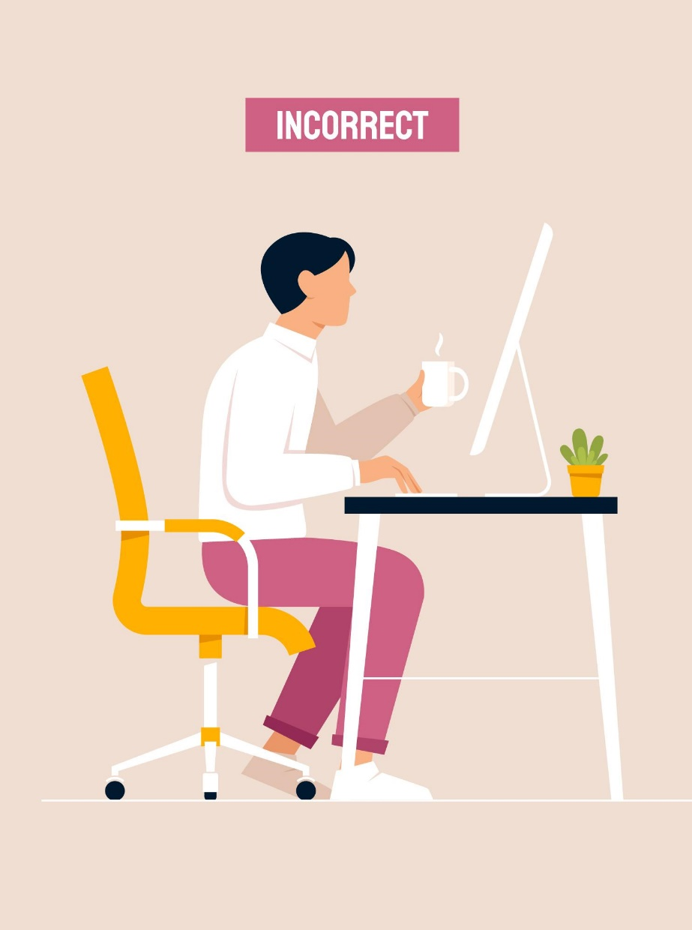
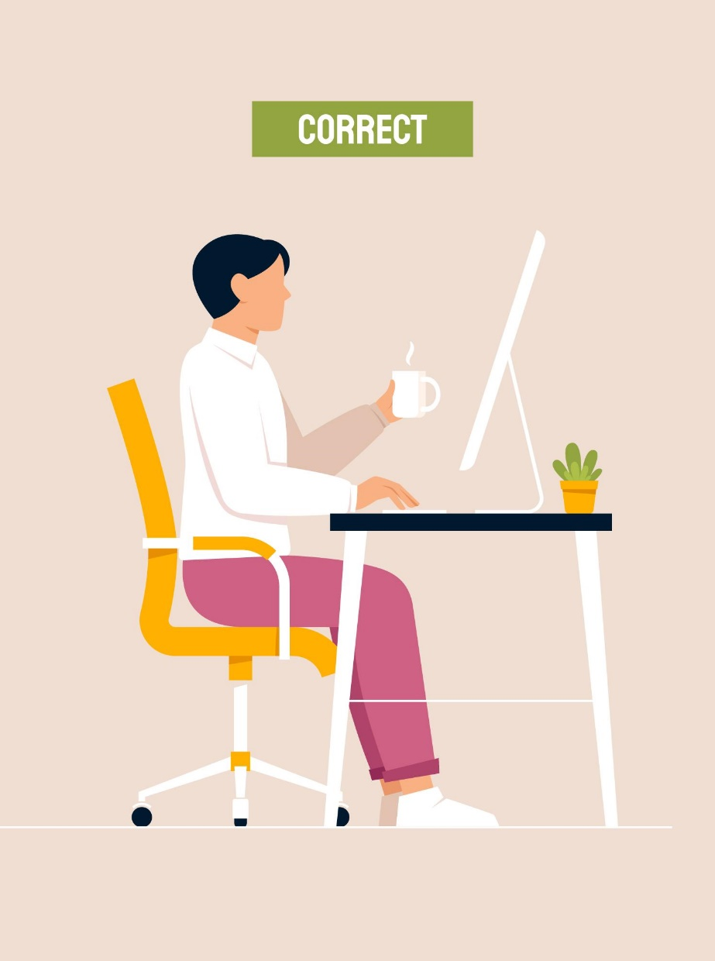
Physical health effects
Poor posture
Sleep problems
Reduced physical activity

Slide 7
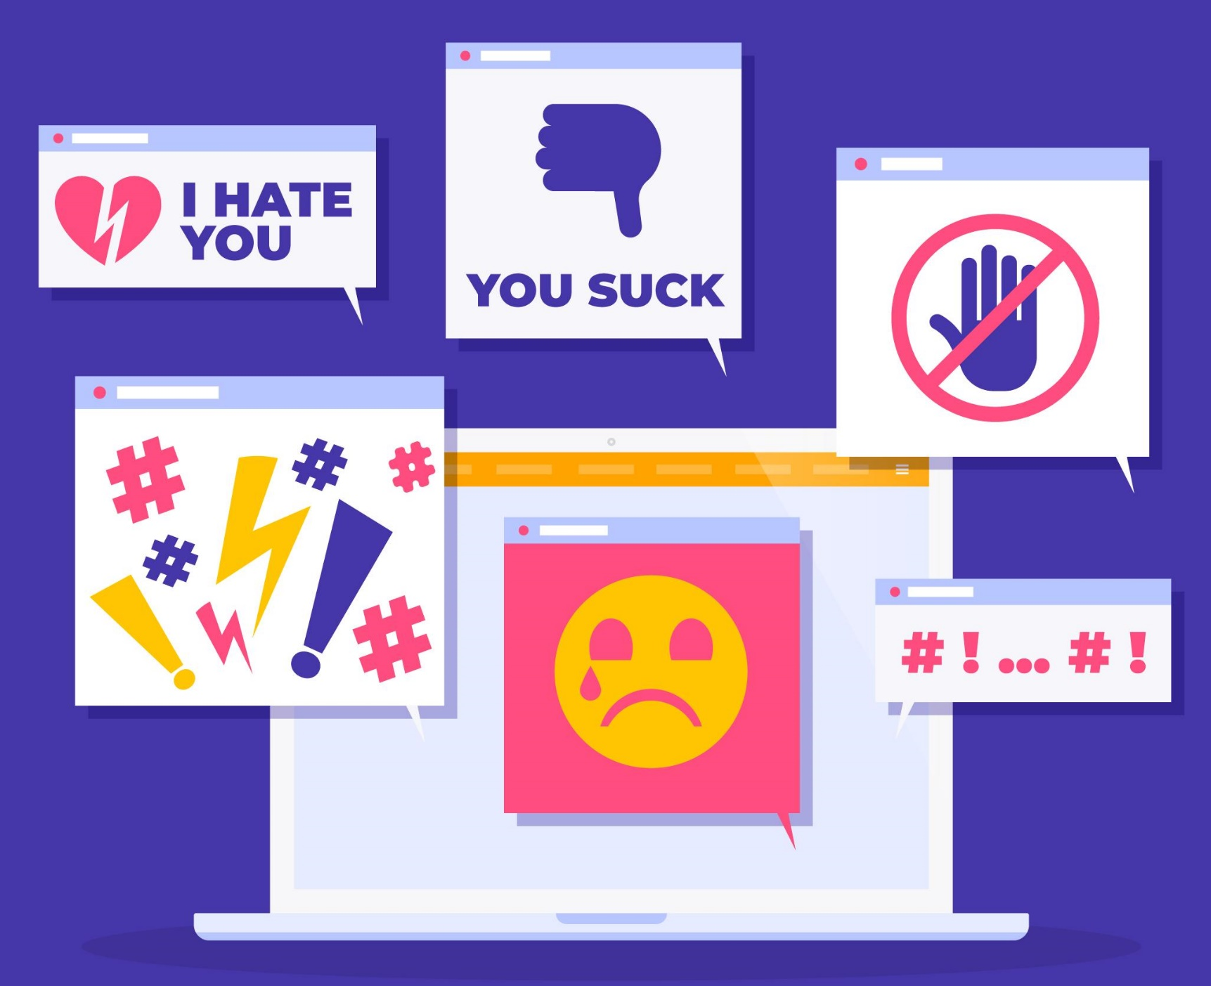
Cyberbullying
Cyberbullying is using technology to harass or bully someone else.
Devices offer bullies opportunities such as email, instant messaging, webpages, and digital photos.
Cyberbullying can range from cruel or embarrassing rumours to threats, harassment, or stalking.
It can affect any age group; however, teenagers and young adults are common victims, and cyberbullying is a growing problem in schools.

Slide 8

How can you protect yourself?
Learn good online habits.
Watch for warning signs in the language used online.
Limit availability of personal information.
If the situation escalates to cyberbullying, communicate this to someone who can help.
Avoid escalating the situation.
Document the activity. Keep a record of any online.
Report cyberbullying to the appropriate authorities..

Slide 9

Psychological effects
Overuse or dependence on technology may have adverse psychological effects, including isolation.
Finding ways to reduce social media use, such as setting time limits for social apps, may help reduce feelings of isolation in some people.

Slide 10

Depression and anxiety
People who had more positive interactions and social support on these platforms appeared to have lower levels of depression and anxiety.
People who perceived that they had more negative social interactions online and who were more prone to social comparison experienced higher levels of depression and anxiety.
There does appear to be a link between social media and mental health – a significant determining factor is the types of interactions people feel they are having on these platforms.

Slide 11
Skills to practise
Protect your health
Keep a calendar of the amount of time that you spend on a digital device per day.
Complete an internet search to find out the maximum time a teenager should spend on a device, especially playing games or on social media.
If you are spending more time than is considered healthy, design a strategy to reduce your screen time.
Continue >

Slide 12
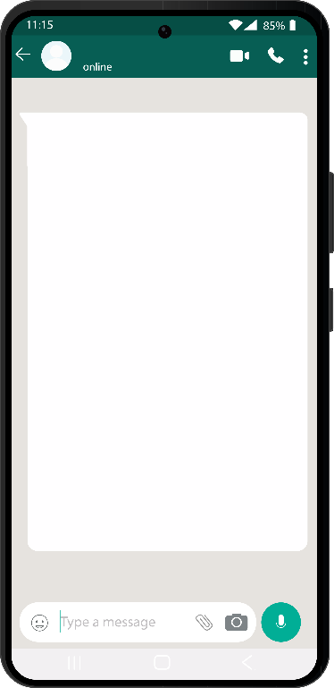
Skills to practise
2. Protect yourself and others
You or one of your friends receive the following message:
Receiving a message like this can be a threat to your safety. Report such a message to a responsible adult immediately.
Consider switching off the GEO location of your device.
If the message is received via social media – change your profile and leave the group.
You may need to delete the app.
Do the same for your friend.
WE KNOW WHO YOU ARE.
WE KNOW WHERE YOU LIVE!
WE ARE COMING FOR YOU!

Slide 13
All back covers should include
contact information of the section
producing the work.
© United Nations Children’s Fund (UNICEF) [month and year of publication]

